Slide 1
CS 498
Virtual Reality
Design Processes
(For internal use only)
Set 4

Slide 2
Ergonomics and VR
Ergonomics: The science of refining the design of products to optimize them for human use
Ergonomics issues with VR
Physical discomfort (limitations of the human body)
Visual discomfort (limitations of stereoscopic viewing)
The weight of the HMD
The kinematic (repetitive motion) issues presented last design class
As Designers, what can we do to lessen the impact of VR ergonomic issues related to HMDs?
We need to define the target comfort zones
The optimal zone to put key content
The optimal zone for UI
The optimal zone to provide interactions within
The sum total of this will drive how our users experience our product

Slide 3
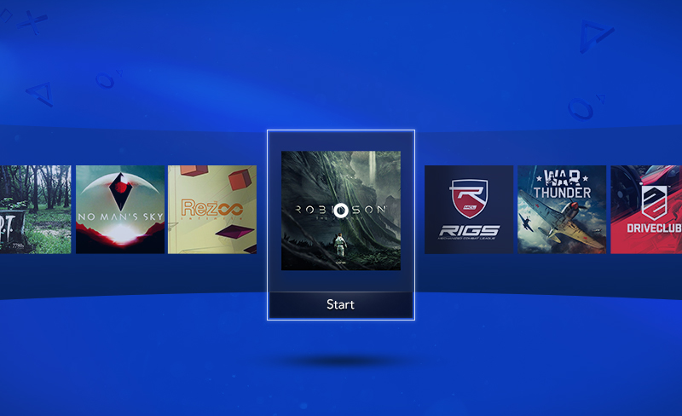
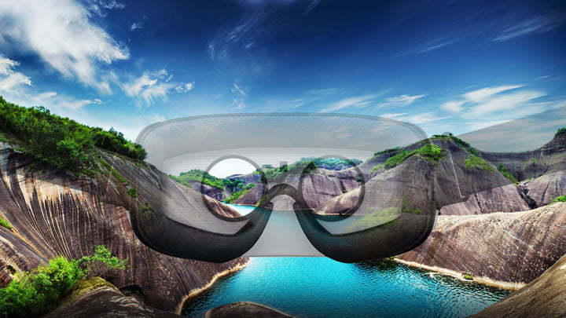
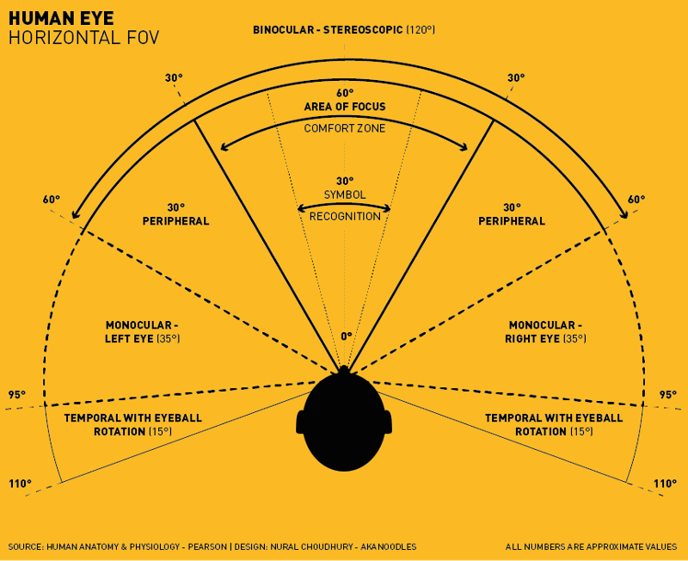
VR Design Specifics: Physical factors that impact Target Zones
Interesting physical limitations (Medich)
Standing: Easier to look left/right
Sitting: Easier to look up/down
Think about this in terms of platform
Head turning can be uncomfortable (Alger)
Recommended view frustum ±35°
Note that an Imax screen is 70° from center seat
Anything over 77° isn’t comfortable for viewing
The center 55° get the primary focus
This is important for specific kinds of applications
Showing a video
Using horizontal panels for user interface
© Nixson Sysanga

Slide 4
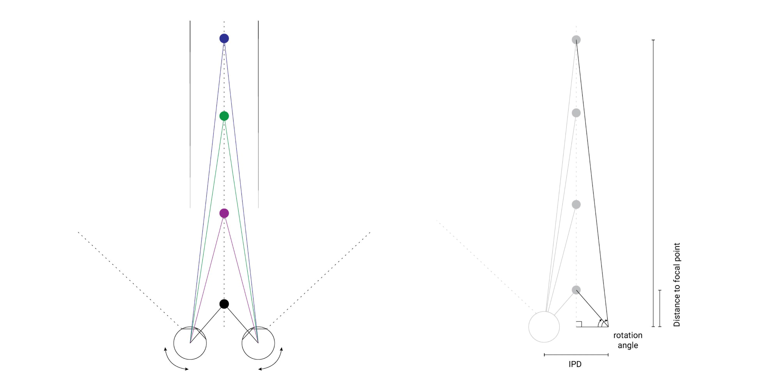
VR Design Ergonomics: Visual Discomfort - The eye’s convergence rotation angle Alger

Slide 5

VR Design Specifics: Joe Ludwig (Valve)
Best Content Depth in VR
Because of the convergence rotational angle of the eye
Anything within .5 meters of the head crosses the eyes
According to Oculus you shouldn’t put anything to read or focus on inside 1 meters
Content in VR shows best between 1 and 10 meters, 10 to 20 meters provides good VR
Anything beyond 20 meters and the eyes see the same image (flattening it out)
Since greater than 20 meters is flat you can fake it.
https://www.youtube.com/watch?v=Tl9BFHslqbU

Slide 6


Slide 7


Slide 8
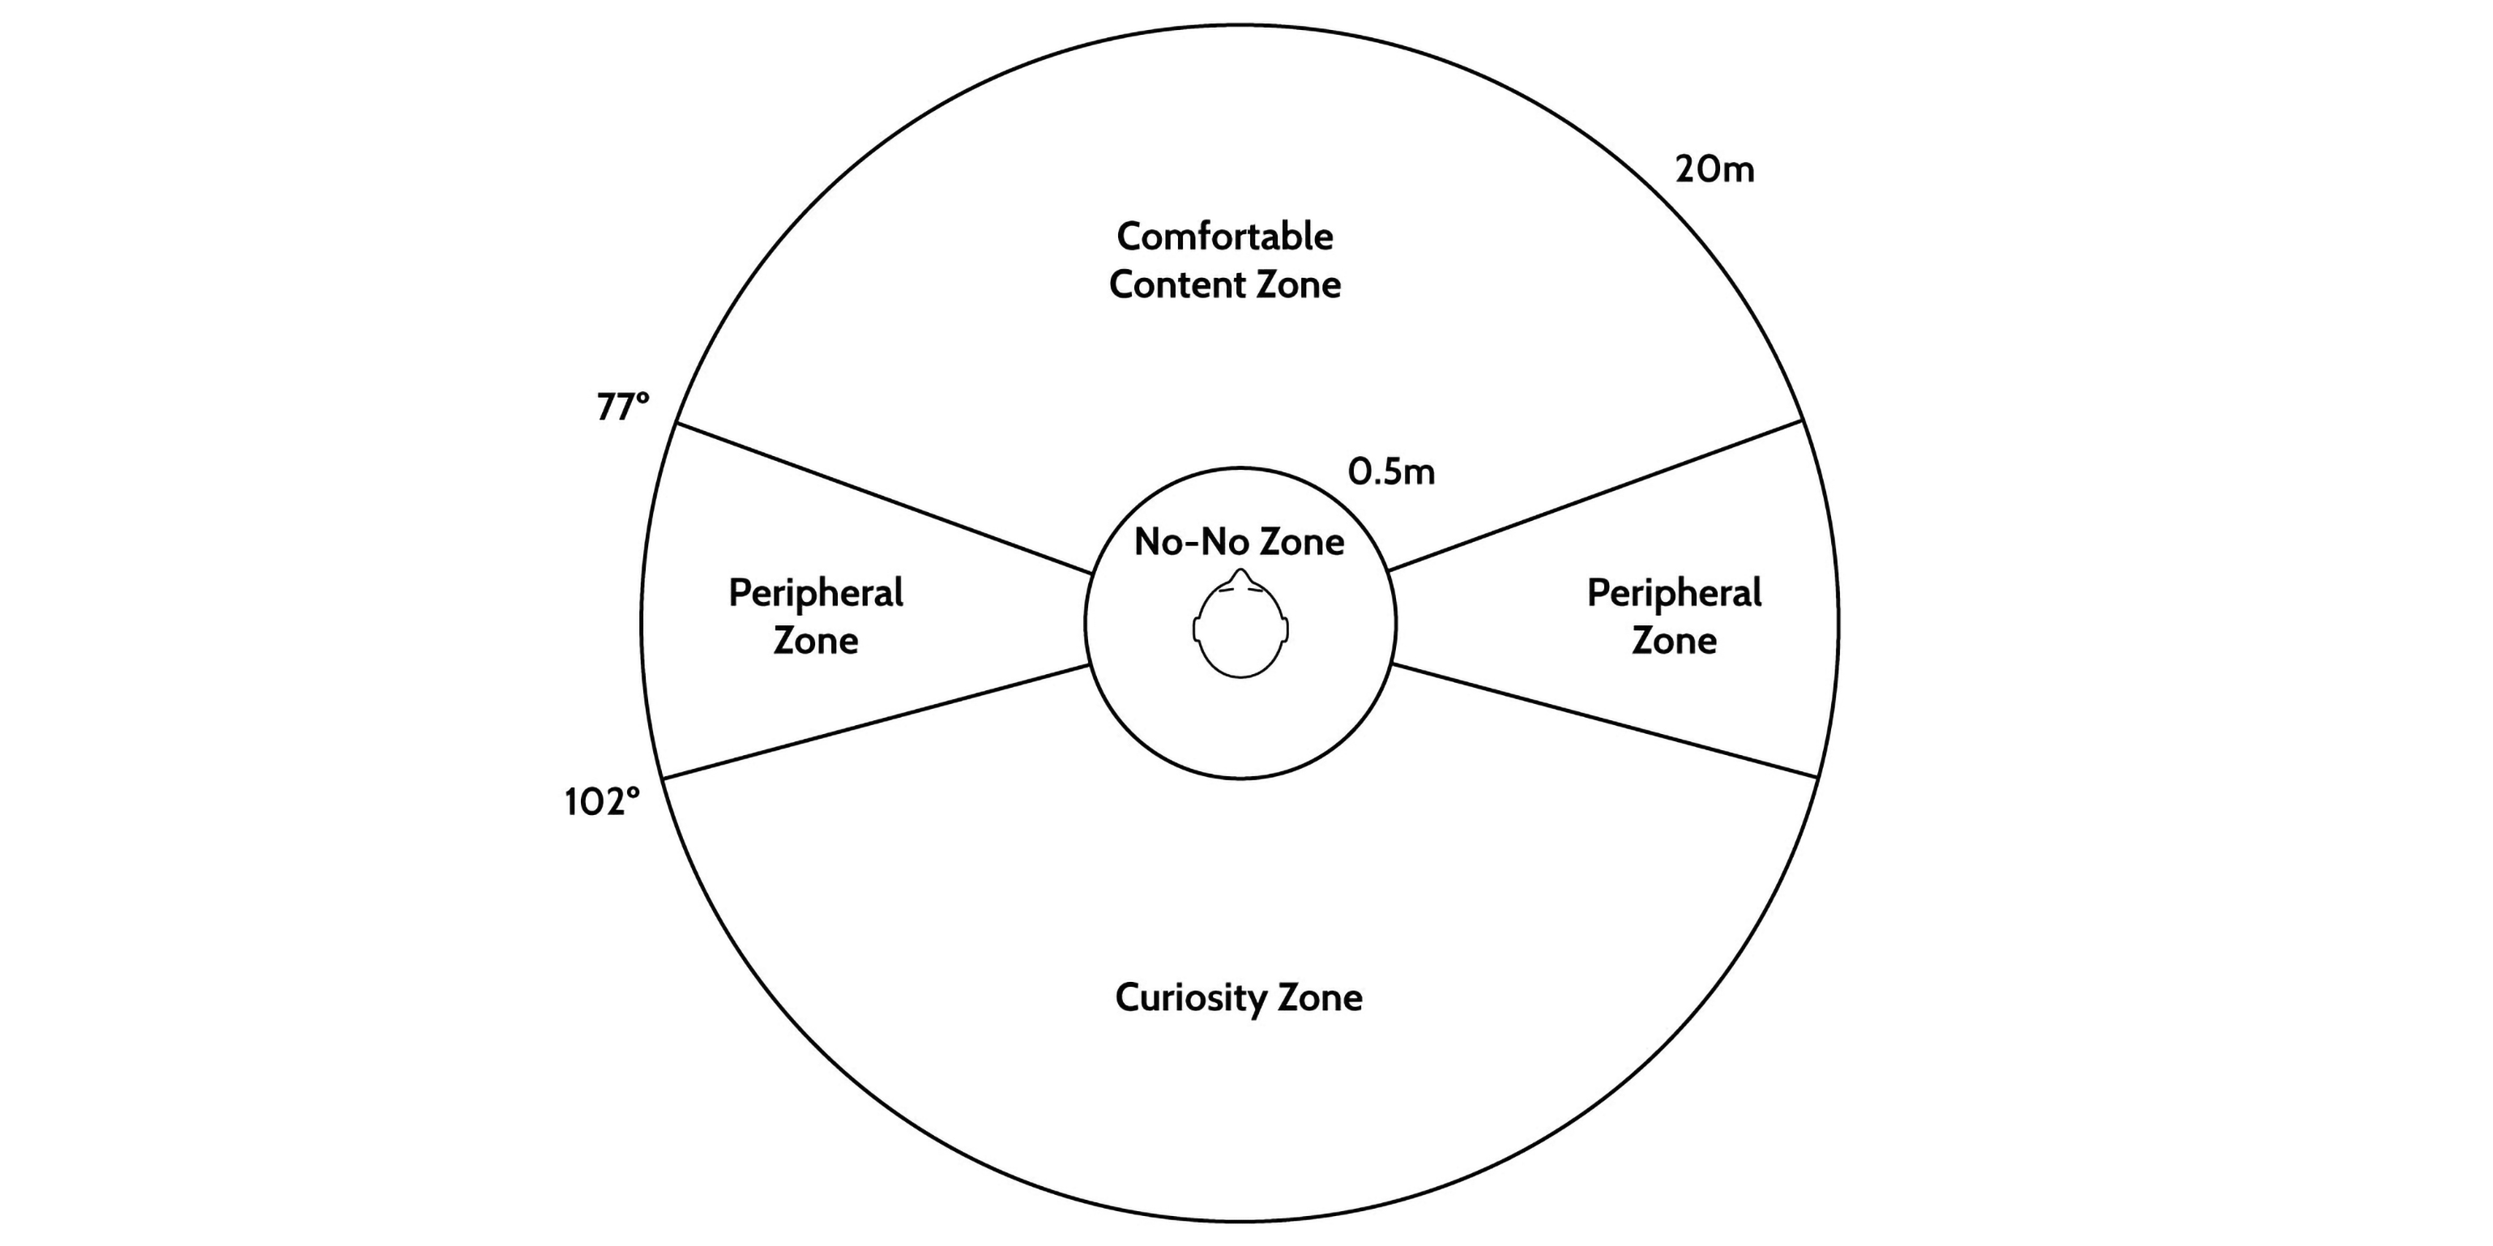
VR Design Ergonomics: User Information zones (Top Down) Alger

Slide 9
VR Design Specifics: Human posture & HMD weight Agler (Google)
Users are impacted by the weight of HMDs
Weight of the average human head: 4500-5000g (10-11 pounds)
Rift: 470g (1.04 pounds)
Vive: 563g (1.24 pounds)
PSVR: 610g (1.34 pounds)
Quest: 571g (1.26 pounds)
HTC Cosmos: Less than the Vive
Valve Index: 807g (1.78 pounds)
Ergonomic studies show that (if sitting) a monitor is should be 15° - 50° below horizon
Accounting For head tilt of 5 ° - 15°
And this doesn’t include the additional weight of an HMD

Slide 10
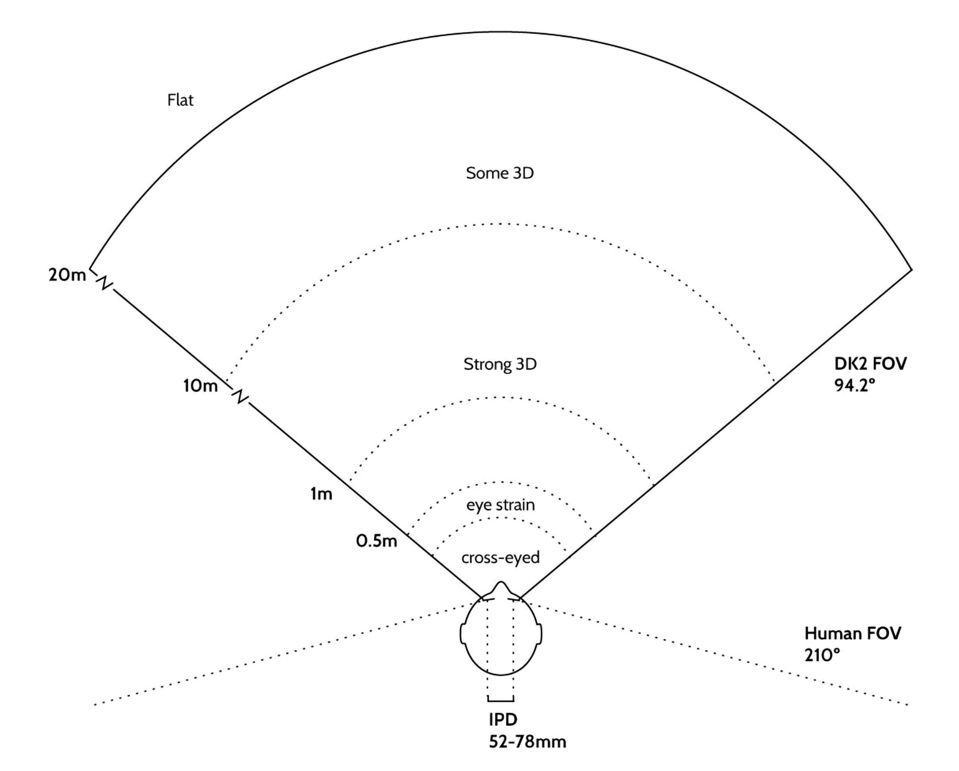
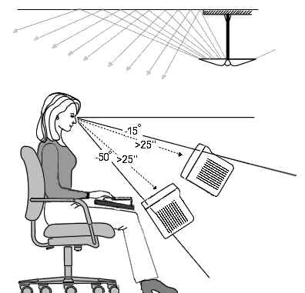
VR Design Specifics – Ergonomics Alger

Slide 11
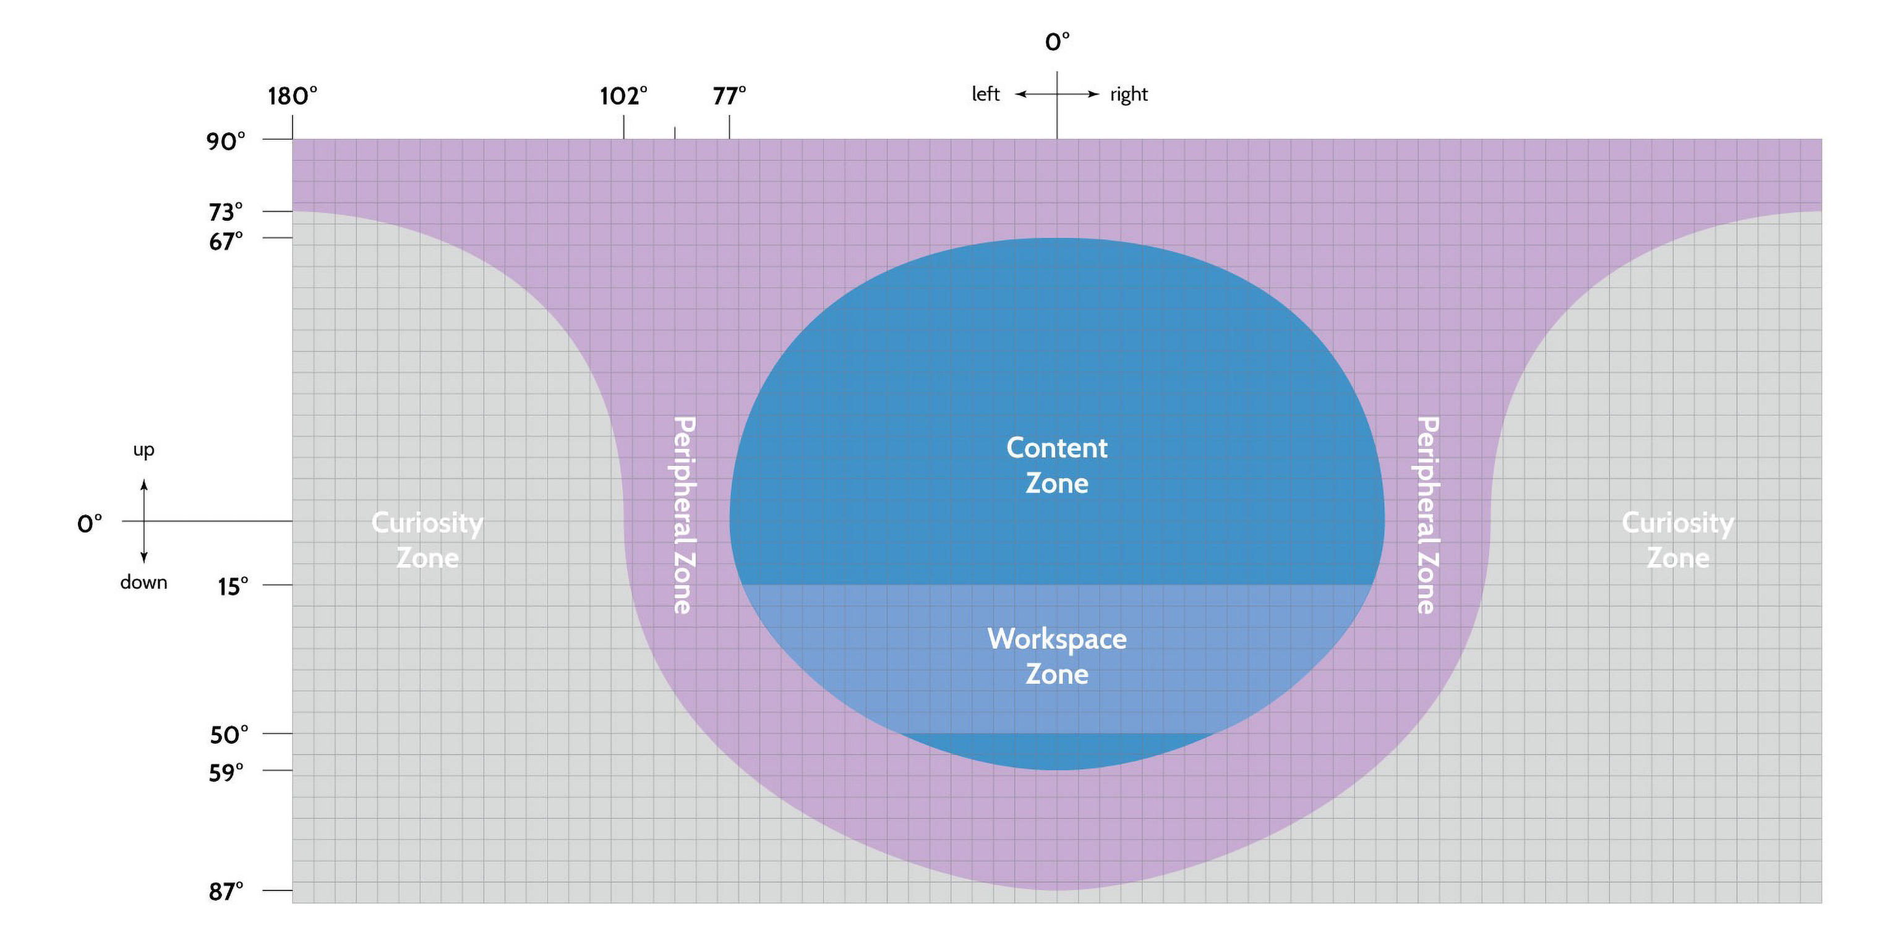
VR Design Ergonomics: User Information Zones (Out of the Eyes) Alger

Slide 12

Examples of where NOT to put interface or content
https://www.youtube.com/watch?time_continue=13&v=O4_kE8EUs9c&feature=emb_logo
https://cs498vr.cs.illinois.edu/projects/FA19-TableTop_WorldBuilder.html
https://cs498vr.cs.illinois.edu/projects/SP19-SpellCasting.html
https://www.youtube.com/watch?time_continue=4&v=Cr3wc1tDLP8&feature=emb_logo

Slide 13
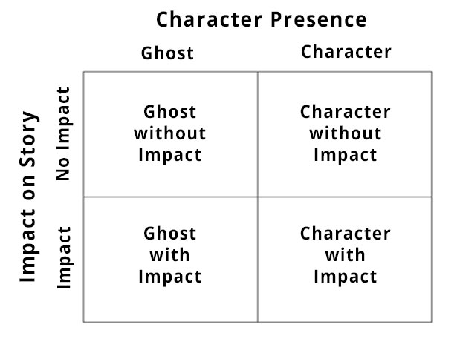
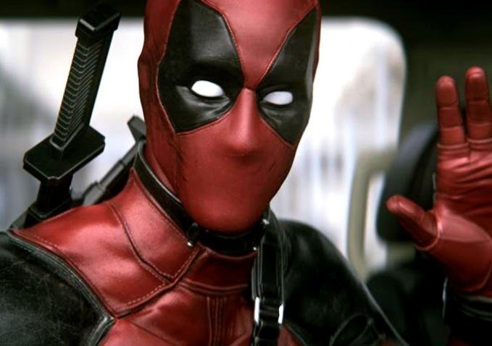
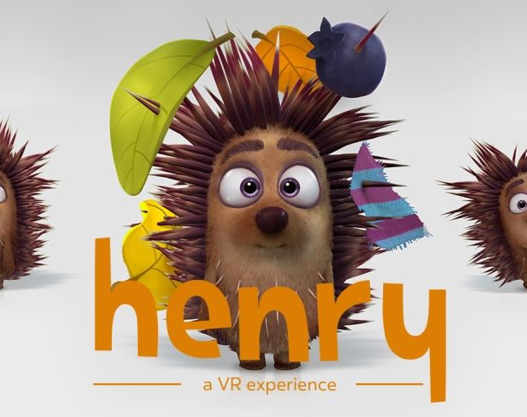
VR Design: General Concerns – Presence & Narrative
Mainstream media (movies, TV, books, most video games) have the “Fourth Wall”
Makes the user the observer
VR places the user in the experience
If 1st Person and the narrative doesn’t address the user as if present, it can be disturbing
You can make the user the observer but there is a loss of presence in that
VR movie makers have an issue with certain kinds of films
Henry (a short about a lonely hedgehog)
https://www.youtube.com/watch?v=IUY2yI5F16U
1:50 & 7:00
© D. Dolan

Slide 14
AR/VR Design requires you to think like a Stage Designer for Theater Christopher Mc Alorum for Venture Beat
1. Define the mise-en-scène
“Mise-en-scène” refers to “everything placed on the stage or in front of the camera — including people. In other words, mise en scène is a catch-all for everything that contributes to the visual presentation and overall look of a production. When translated from French, it means ‘placing on stage.’”
Acknowledging the size, shape, and layout of an indoor/outdoor space directs a performance’s mise-en-scène, ultimately the design aspect of theater production. It is the visual theme or telling of a story.
2. Use proxemics
Apply the study of proxemics — how humans use space when we are communicating, the manipulation of space and spatial relationships among people, (digital) objects, and setting/location.
Where to anchor content?
What scale should the digital content be at this location?
How should this make the user feel?
By answering such design questions, combining unique location, digital content, and storytelling, AR experiences can avoid becoming stagnant and billboard-like.

Slide 15
AR/VR Design requires you to think like a Stage Designer for Theater Christopher Mc Alorum for Venture Beat
3. Use composition
The pleasing arrangement of actors/digital content within the theater ground plan/map of the location for the AR experience that lets the audience/users know where to look at a given moment. Drafting a ground plan indicates the proxemic potential of the actors/digital content and the theater space.
The purpose is to discover dramatic actions and to illustrate these in the simplest possible way through emphasis or contrast. Composition does not require movement at all, it is a static caught movement in time and space, leading the audience to see what the director/AR UX designer believes is essential. It concerns itself with clarity like a still life painting of the stage at one moment in time.
4. Use blocking
“The theater demands democracy for the same experience from every angle,” notes stage designer Es Delvin, and it is blocking, the choreography of the play/AR/VR experience which promotes such. It is clarifying the movement of the actors/digital content or users and the unique relationships of the characters.
The physical distance between people can relate to social, cultural, and environmental factors, even stressing character and plot development. Something as simple as strategic placement, lighting, and controls can make an emotional impact for the user.

Slide 16
AR/VR Design requires you to think like a Stage Designer for Theater Christopher Mc Alorum for Venture Beat
5. Use picturization
A process by which we add meaning, the storytelling aspect of blocking. The stage designer Minglu Wang asserts, “I am not only designing what the audience can see on stage but also the empty space that they can’t see.” Picturization tries to get across subtext — the meaning that may not be supported by the words. It is the visual interpretation of each movement at play so that the dramatic nature of the situation will be covered to the audience / users without the use of dialogue and action. It allows the designer to explore and discover. In Japanese theater, “Mie” or “frozen moment” is a powerful and emotional pose struck by an actor who then freezes for a moment. It is meant to show a character’s emotions at their peak, one that remains in the mind of the viewer.
6. Collaborate within a vision
The AR/VR Designer is a leader of collaborators working towards a sole vision similar to a scenographer, who is responsible for all of the aesthetics of a performance.
7. Design for the human locale
What does theater do? According to Ariane Mnouchkine, Ibsen theater award winner and cofounder of the Théâtre du Soleil, “theater is a ritual, one should go out of the theater stronger and more human than when you went in … epic theater is where the audience shares a moment of consciousness.”

Slide 17
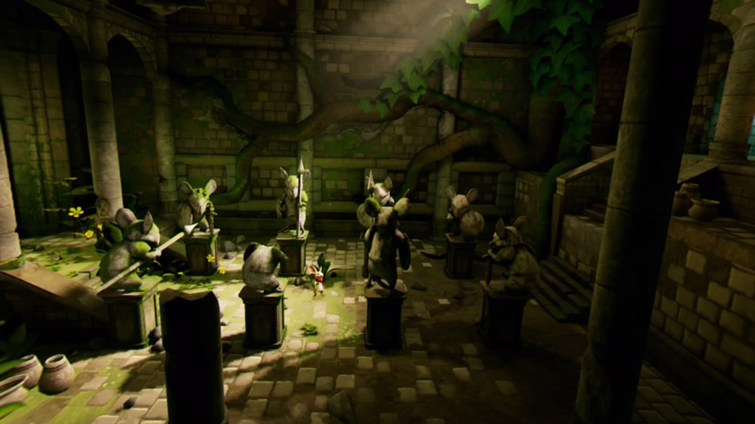
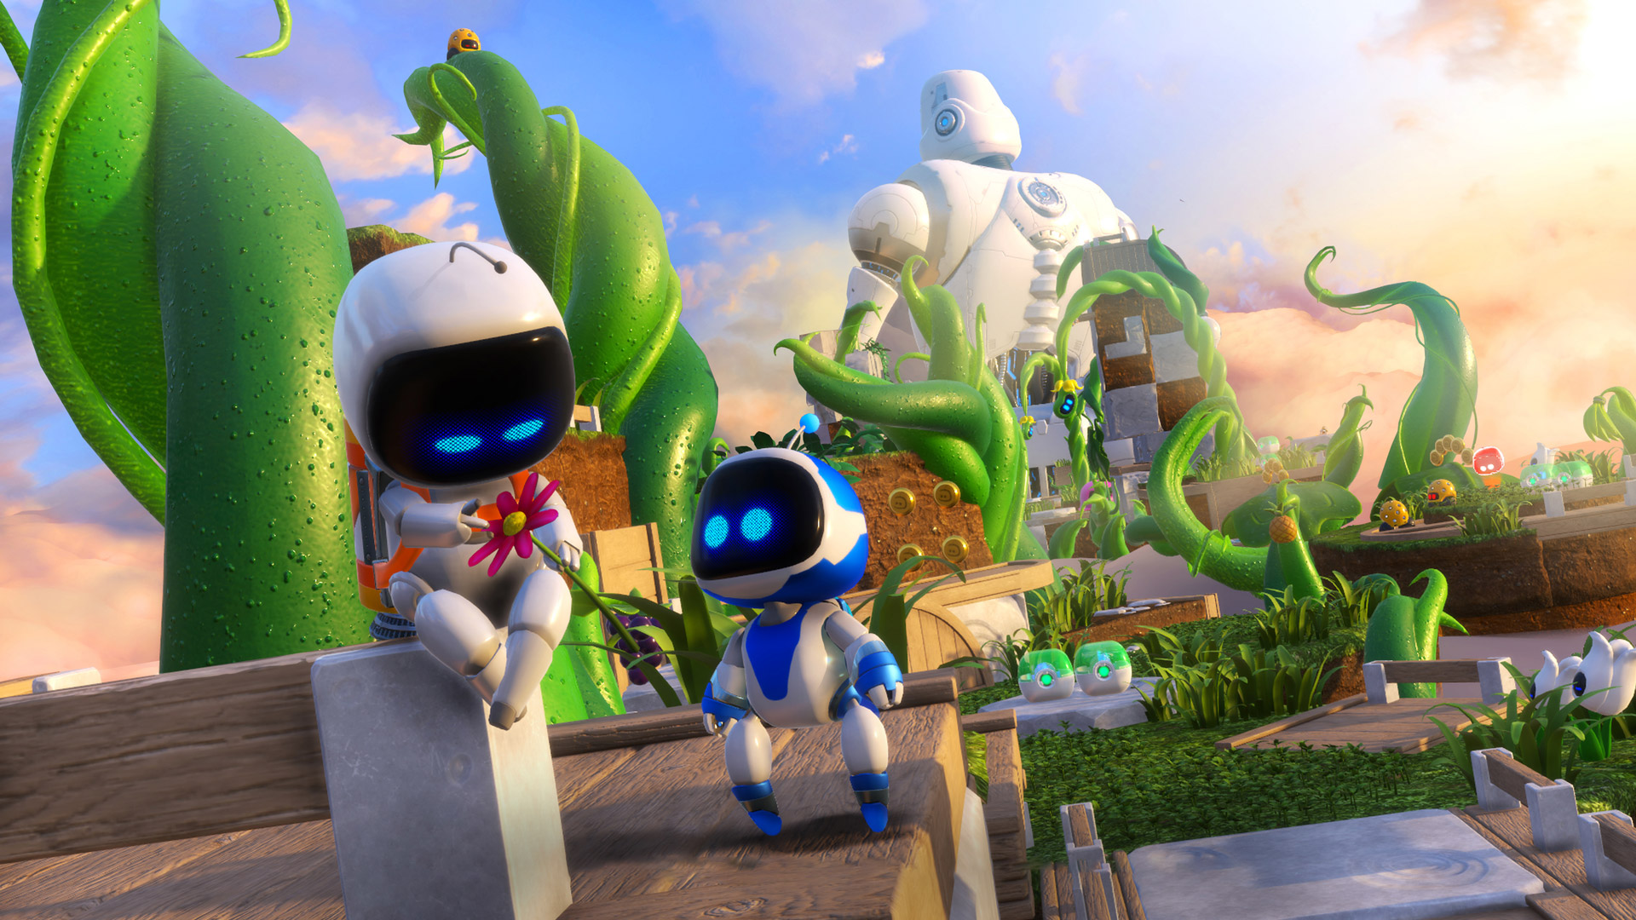
VR Design: General Concerns – Presence & Narrative
VR Games use 3rd person (Ghost with Impact) often
Moss and Astro Bot are very successful 3rd person games

Slide 18
VR Design: User Intent
Key aspect of User Experience
There are experiences you will want the user to have but what comes first?
What does the user want to do vs what do you want him to do?
How do you get the two elements to match?
Choice!
Don’t have one hierarchy of choices, give the user the freedom to choose their own path
Make sure the know what the choices are (get their attention).
Then Simplicity (it’s the old adage of KISS, Keep It Stupid Simple) – yeah I know it ain’t right
Take their intent and make it happen quickly and simply, don’t make the user work

Slide 19
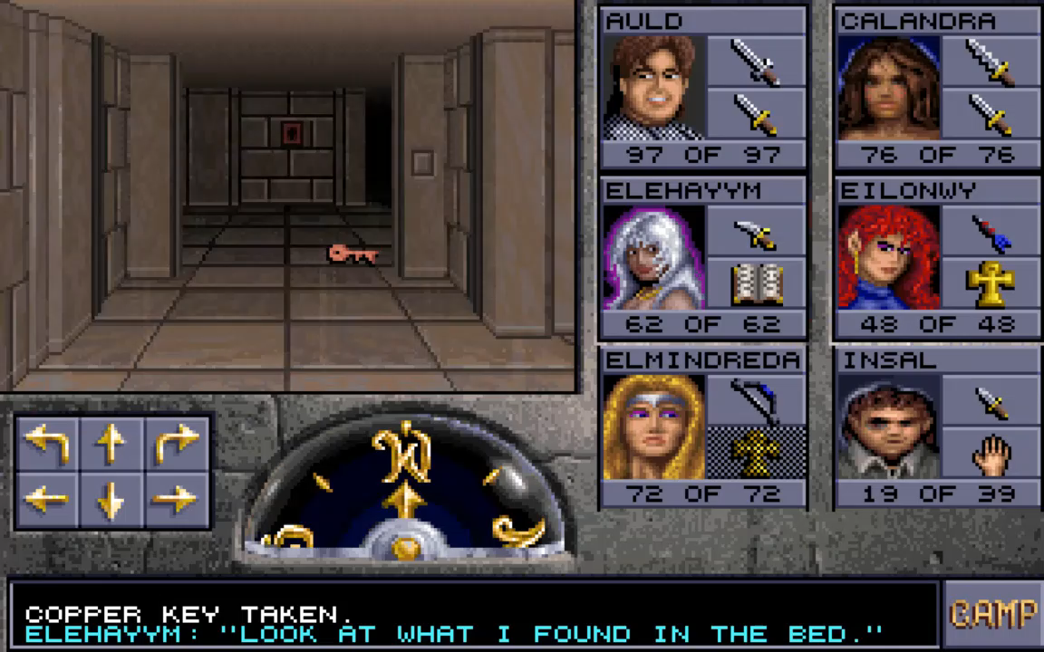

Slide 20


User Intent: Getting their Attention, so they can choose
Think about things that draw your attention in the real world
Pause, consider your user
Sound
Funnels, borders, elements that constrict flow
Things that standout against the background
Something out of place
Movement
https://www.hr.uillinois.edu/benefits/
https://accessibility.colostate.edu

Slide 21
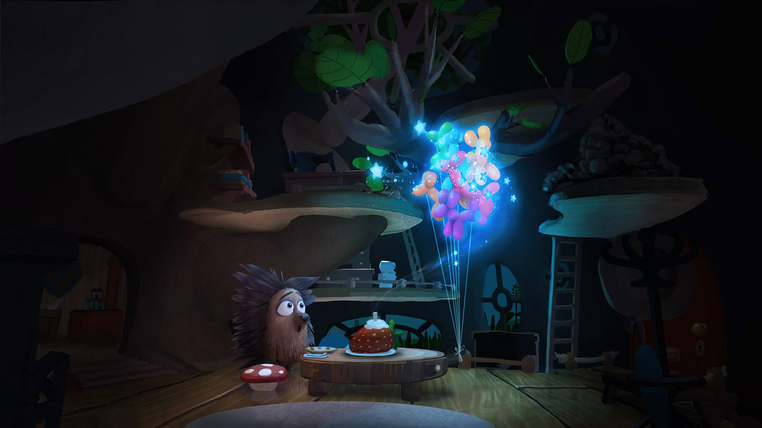
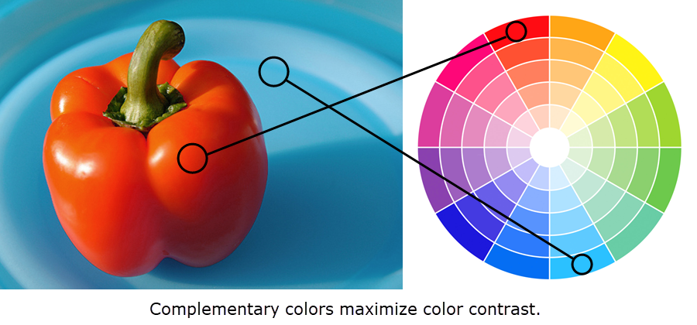
User Intent: Getting their Attention
Contrast is very powerful
Using Color is key
Lighting changes
Torn uses lighting very well
https://www.youtube.com/watch?v=fcjf_t05BYQ
Oculus Story Studio
https://accessibility.colostate.edu

Slide 22
User Intent: Getting their Attention
Torn uses lighting very well
https://www.youtube.com/watch?v=fcjf_t05BYQ

Slide 23
Getting their Attention – Audio
Audio is hard but is key to a successful VR experience
The auditory systems are very sensitive and update faster than the visual systems
Audio from outside the experience will disconnect the user from your experience
Audio done right will draw the user in, affirming the experience
It can set mood
Supply the implication of content presence without the content (bird sounds)
Needs to provide the key details of the world and be localized
Techniques for successful VR audio
Audio matching content in the near, mid-range and far range zones
Ducking (lowing non-important audio)
Listening Angle (things outside your FOV are attenuated)
https://www.google.com/search?q=Back+to+dinosaur+Island+VR+demo&rlz=1C1CHBF_enUS802US802&source=lnms&tbm=isch&sa=X&ved=0ahUKEwjS4_Kr5q_gAhVL7YMKHd9RBLoQ_AUIECgD&biw=973&bih=935#imgrc=btjTyrFfrWCgLM:

